Slide 1
Personality

Slide 2
Personality is the pattern of enduring characteristics that produce consistency and individuality in a given person. Personality encompasses the behaviors that make each of us unique and that differentiate us from others. Personality also leads us to act consistently in different situations and over extended periods of time.

Slide 3
Defining Some Terms
Character: Personal characteristics that have been judged or evaluated
Temperament: Hereditary aspects of personality, including sensitivity, moods, irritability, and adaptability
Personality Trait: Stable qualities that a person shows in most situations
Personality Type: People who have several traits in common

Slide 4
How do psychologists define and use the concept of personality?

Slide 5
1. Psychodynamic approaches to Personality
It emphasize that personality is primarily unconscious (that is, beyond awareness). According to this viewpoint, those enduring patterns that make up personality are largely unavailable to our conscious awareness, and they powerfully shape our behaviors in ways that we cannot consciously comprehend.
Psychodynamic theorists also stress the role of early childhood experience in adult personality. From this vantage point, the adult is a reflection of those childhood experiences that shape our earliest conceptions of ourselves and others.

Slide 6
2. Trait Approaches
Approaches that propose that there are certain traits that form the basis of an individual’s personality.
These approaches seek to identify the basic traits necessary to describe and understand personality.

Slide 7
Eysenck’s Dimensions of Personality
Two major dimensions:
Introversion-extroversion,
Neuroticism-stability.
Introvert
Quiet, passive, and careful people.
Extroverts
Outgoing, sociable, and active people.
Neurotics
Moody, touchy, and anxious people.
Stable
Calm, carefree, and even-tempered people.

Slide 8
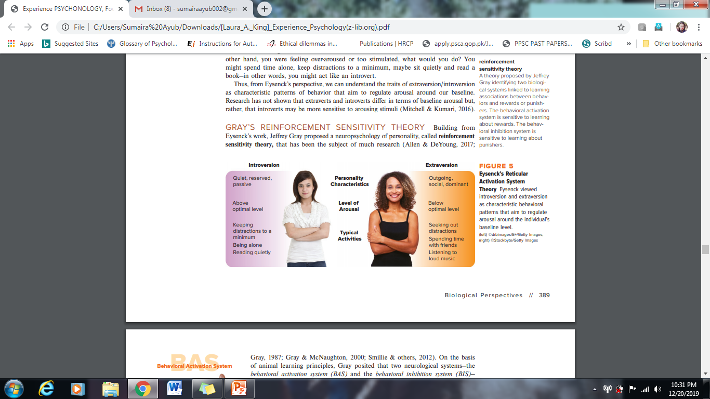

Slide 9
Big Five Personality Traits

Slide 10
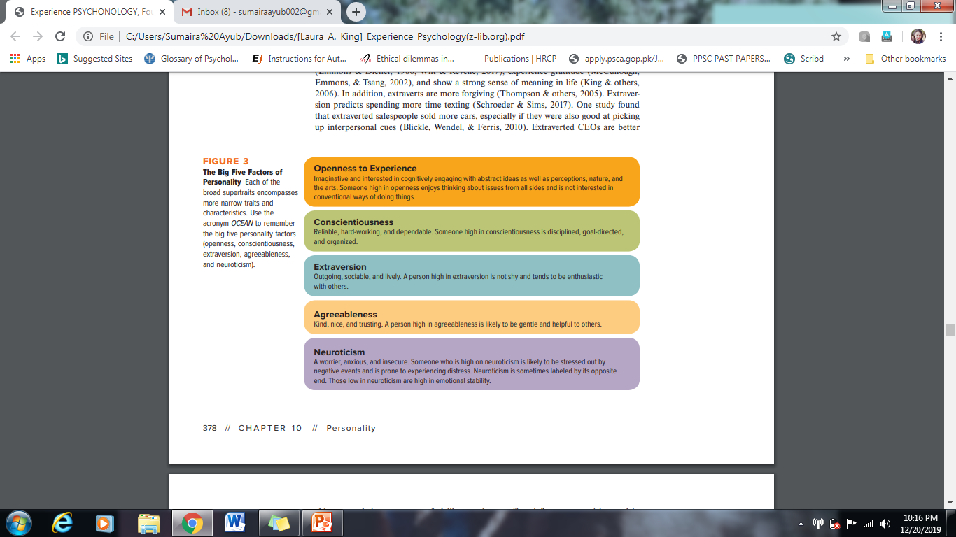

Slide 11
3. Social Cognitive Perspectives
Social cognitive theory states that behavior, environment, and person/ cognitive factors are important in understanding personality. In Bandura’s view, these factors reciprocally interact. Two key concepts in social cognitive theory are self-efficacy and personal control.
Self-efficacy is the belief that one can master a situation and produce positive outcomes. Self-efficacy is also linked with successful job interviewing, job performance, and achievement in a creative profession.

Slide 12
Personal control refers to individuals’ beliefs about whether the outcomes of their actions depend on their own internal acts or on external events.
Imagine someone—let’s call him Raoul—who is excited by the challenge of a new assignment given by his boss. Raoul may think about all the possible strategies to complete the project and get down to work immediately. Yet this go-getter may respond differently to other challenges, depending on who gives the assignment, what it is, or whether he feels he can do a good job

Slide 13
4. Humanistic Perspectives
Humanistic perspectives stress a person’s capacity for personal growth and positive human qualities. Humanistic psychologists believe that we all have the ability to control our lives and to achieve what we desire.
Maslow developed the concept of a hierarchy of needs, with self-actualization being the highest human need.
In Rogers’s approach, each of us is born with a tendency toward growth, a sense of what is good and bad for us, and a need for unconditional positive regard. Because we are often denied unconditional positive regard, we may become alienated from our innate growth tendencies. In order to reconnect with these innate tendencies, Rogers felt, a person required a relationship that included unconditional positive regard, empathy, and genuineness.

Slide 14
If we have innate tendencies toward growth and fulfillment, why are so many people so unhappy? The problem arises when our need for positive regard from others is not met unconditionally.
Unconditional positive regard is Rogers’s term for being accepted, valued, and treated positively regardless of one’s behavior.

Slide 15
Personality Assessment
Interview: Face-to-face meeting designed to gain information about someone’s personality, current psychological state, or personal history
Unstructured Interview: Conversation is informal, and topics are discussed as they arise
Structured Interview: Follows a prearranged plan, using a series of planned questions
Direct Observation: Looking at behavior

Slide 16
Self report Measures
Self report test, which directly asks people whether specific items describe their personality traits. Self-report personality tests include items such as:
I am easily embarrassed.
I love to go to parties.
I like to watch cartoons on TV.
Minnesota Multiphasic Personality Inventory (MMPI)
used to assess “abnormal” personality tendencies
a tool for hiring decisions
in forensic settings it is used for assessing criminal risk
Honesty (Integrity) Test: Assumes that poor attitudes toward dishonest acts predispose a person to dishonest behavior

Slide 17

Inkblot

Slide 18
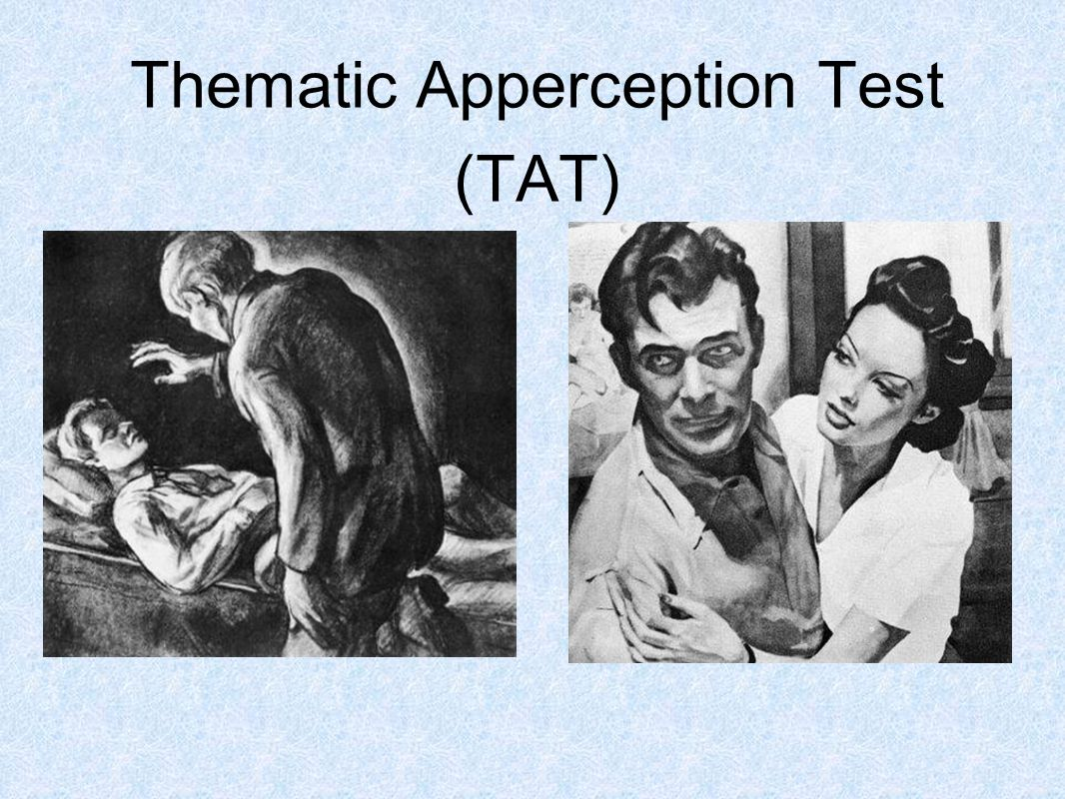

Slide 19
What are this man and woman thinking and feeling? How did they come to this situation, and what will happen next?
A psychologist who uses the TAT would analyze your story to find out your unconscious motives.

Slide 20
Other Types of Personality Assessments
Behavioral Assessment: Recording the frequency of specific behaviors
Situational Test: Real life situations are simulated so that someone’s spontaneous reactions can be recorded
Leaderless Group Discussion: Test of leadership that simulates group decision making and problem solving

Slide 21
Thank You ☻

